Slide 1
Local Search and CSP
CS161
Guy Van den Broeck

Slide 2
Local Search
Sometimes the path to the goal is irrelevant
Only final configuration matters
? n-queens, circuit design, road network, crypt-arithmatic, rubik, sliding tile, TSP?
Modify a single current node (constant space)
Good for optimization problems
objective function

Slide 3

Continuous Case

Slide 4
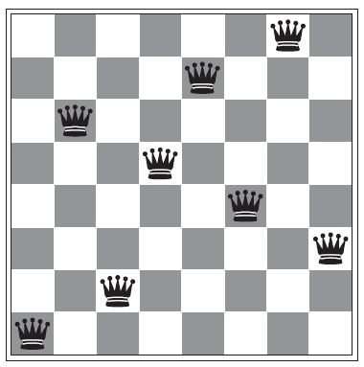
Hill-Climbing Search
Which direction is walking up the hill?

Slide 5
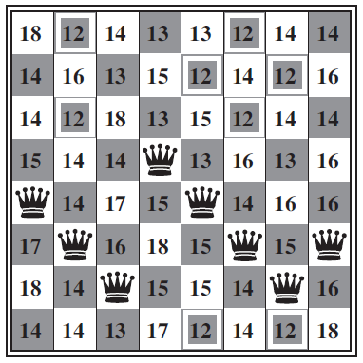
Hill-Climbing Search

Slide 6
How to locally modify TSP?

Slide 7
Beam Search

Slide 8
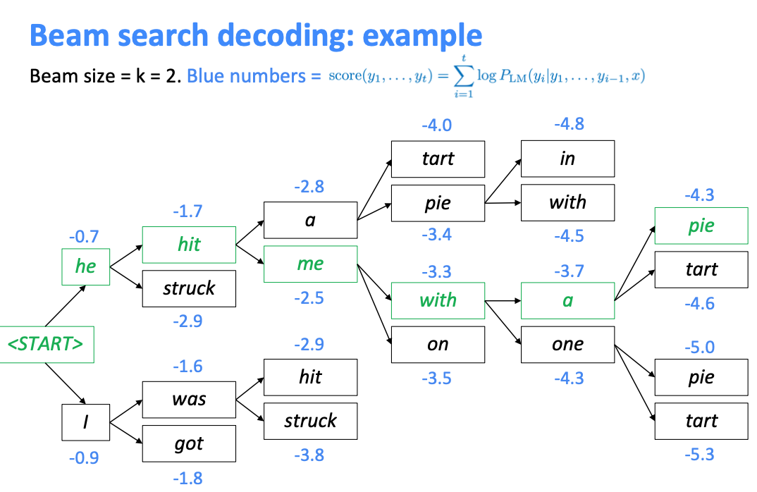
https://vinija.ai/concepts/token-sampling/

Slide 9
Simulated Annealing
Randomly select candidate successor
Go there if better
Else go there with probability
function of “energy” and “temperature”

Slide 10
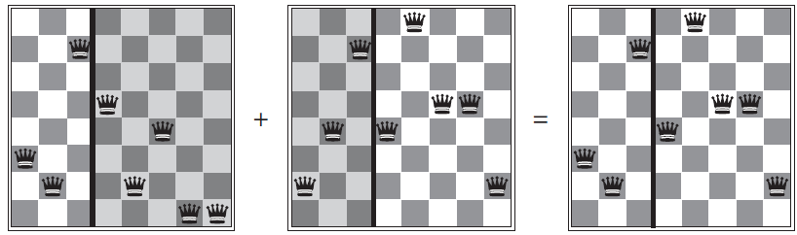
Genetic Algorithms

Slide 11
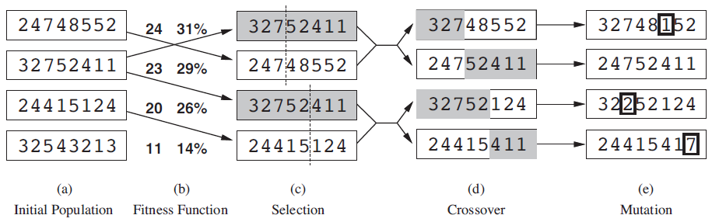

Slide 13
= 11 / (24+23+20+11)

Slide 17
Genetic Algorithms
Their popularity comes in waves
Currently: Way of doing neural architecture search
(learning a `good` structure for your machine learning model; number of layers, etc.)

